Slide 1
Annual Interagency Accessibility Forum
Enabling Missions through Accessible Technology – Leaving No One Behind
October 6 & 7, 2020
10th Anniversary of the Twenty-First Century Communications and Video Accessibility Act
Disability Rights Office – Federal Communications Commission

Slide 2


The Commission’s Disability Rights Office
Modern Communications
Video Programming
Emergency Communications
Closing the digital divide
Promoting innovation
Protecting consumers and public safety
Reforming the FCC’s processes

Slide 3

CVAA in a Nutshell
Purpose of CVAA?
Amends the Communications Act
Title I – Communications Access
Title II – Video Programming

Slide 4




CVAA Title I: Communication Access
Advanced Communications Services
Internet browsers on mobile phones
Telecommunications Relay Services
Equipment for deafblind individuals
Hearing aid compatibility rules
Next Generation 9-1-1 services

Slide 5
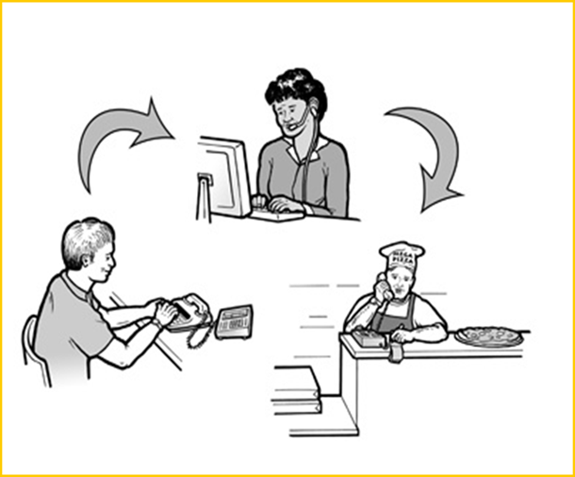
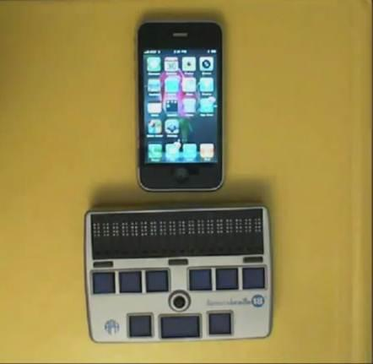

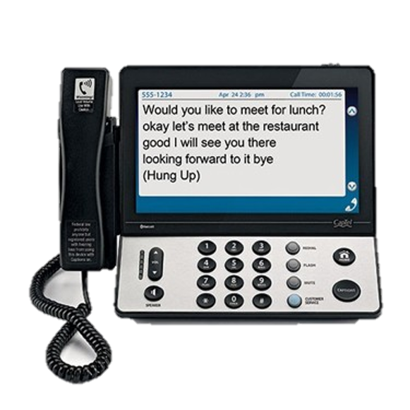
CVAA Title I: Communication Access

Slide 6


CVAA Title II: Video Programming
Closed Captioning for Video Programming
FCC Rule for TV - 47 C.F.R. § 79.1
FCC Rule for Internet - 47 C.F.R. § 79.4
Audio Description
FCC Rule for TV – 47 C.F.R. § 79.3
Emergency Information – 47 C.F.R. § 79.2
User Interfaces and Program Guides
47 C.F.R. § 79.107-109

Slide 7

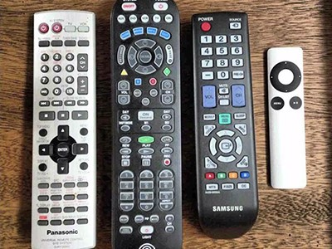
CVAA Title II: Video Programming

Slide 8
Your Resources
Subscribe to AccessInfo@fcc.gov.
Visit FCC Disability Rights Office webpage: www.fcc.gov/accessibility.
Contact FCC DRO at:
DRO@fcc.gov (e-mail)
844-432-2275 (videophone)
202-418-2517 (voice)
Online Complaint Form: www.fcc.gov/complaints.
THANK YOU FOR MAKING A DIFFERENCE.

